Slide 1
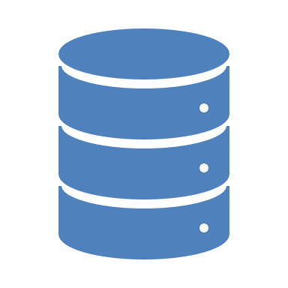
RELATIONAL & NON-RELATIONAL DATABASE

Slide 2

DEFINITION OF RELATIONAL DATABASE
Relational Database (RDB): this is a type of database that stores and organizes data into structured tables consisting of rows and columns. It follows strict rules to keep everything structured and connected, data in this category are related through predefined relationships. i.e. Primary and Foreign Keys. Relational databases use structured query language (SQL) for querying and managing data. Examples of RDB are Microsoft SQL, MySQL, PostgreSQL.

Slide 3

DEFINITION OF NON-RELATIONAL DATABASE
Non-Relational Database: This type of database stores data more flexibly, not always in tables. Instead, it stores data in various formats, such as key-value pairs, documents, graphs, or wide-column stores. It is designed for flexibility, scalability, and handling unstructured or semi-structured data. It's great for big, fast-changing data like social media or real-time apps. Example includes MongoDB, Redis, etc.

Slide 4
DIFFERENCE BETWEEN RDBS & NRDBS
Relational and non-relational databases are two primary types of database systems, each designed for different use cases and requirements.

Slide 5
CHARACTERISTICS DIFFERENCE
Aspects | Relational Database Management System (RDBMS) | Non-Relational Database Management System (RDBMS)
Data Model | Structured, organized into tables (rows & columns) | Flexible, uses various formats (e.g. key-document, graph)
Schema | Fixed schema: data must conform predefined structure. | Schema-less or flexible schema: data structure can vary
Query Language | Uses SQL (Structured Query Language) | Varies by database type; commonly used API
Data Relationship | Enforces strict relationships (primary and foreign keys) | Support relationships but typically less strict; often embedded
Transactions | Supports ACID properties (Atomicity, Consistency, Isolation, Durability) | Often supports BASE (Basically Available, Soft State, Eventual Consistency)

Slide 6
USE CASE DIFFERENCE
RELATIONAL DATABASE MANAGEMENT SYSTEM (RDBMS) | NON-RELATIONAL DATABASE MANAGEMENT SYSTEM (N-RDBMS)
Used for applications requiring complex queries and transactions | Used for applications with unstructured, semi-structured and highly varied data
Examples of use: banking, accounting, and ERP systems | Example of use: social media, IoT, real-time analytics
Used on inventory management, CRM systems and e-commerce platforms | Used for content management systems, mobile apps, big data applications

Slide 7
ADVANTAGES OF RDBMS
Data Integrity: RDBMS enforces strict rules for data accuracy and relationships.
Mature Ecosystem: RDMS is widely used with well developed tools and standards.
Standardized Querying: SQL is universally known and consistent.
Transaction Support: it is reliable for applications requiring consistency and durability.

Slide 8
ADVANTAGES OF N-RDBMS
Scalability: it is designed for horizontal scaling and ideal for large datasets.
Flexibility: It supports dynamic schemas and multiple data formats.
Performance: Optimized for fast reading/writing operations in distributed systems.
Adaptability: it is suited for modern applications with rapidly changing data requirements

Slide 9
Popular Examples of RDBMS
Microsoft SQL Server
MySQL
PostgreSQL
Oracle Database
MariaDB

Slide 10
Popular Examples of N-RDBMS
MongoDB (mostly uses documents)
Redis (used for key-value)
Neo4j (graphs)
Apache Cassandra (for wide columns)
Amazon DynamoDB (backups)

Slide 11
WHEN TO USE RDBMS
Used when data is structured
Used when strong data integrity and accuracy is required
Used when advanced SQL queries, joins and aggregations are frequently needed
Used for predefined schema, when data structure is stable and unlikely to change often
Use case examples:
Customer and order management in e-commerce
Accounting systems with strict data consistency requirements

Slide 12
WHEN TO USE N-RDBMS
Data is Unstructured or Semi-Structured: Data includes text, images, videos, or JSON documents.
Scalability is a Priority: High traffic or large volumes of data require horizontal scaling.
Data is Rapidly Changing: Schema flexibility allows adapting to changing data structures.
Real-Time Performance is Needed: Fast reads/writes are essential (e.g., caching, social media feeds).
Use Case Examples:
Storing user profiles in a social media app.
Logging and monitoring systems in a cloud application.

Slide 13
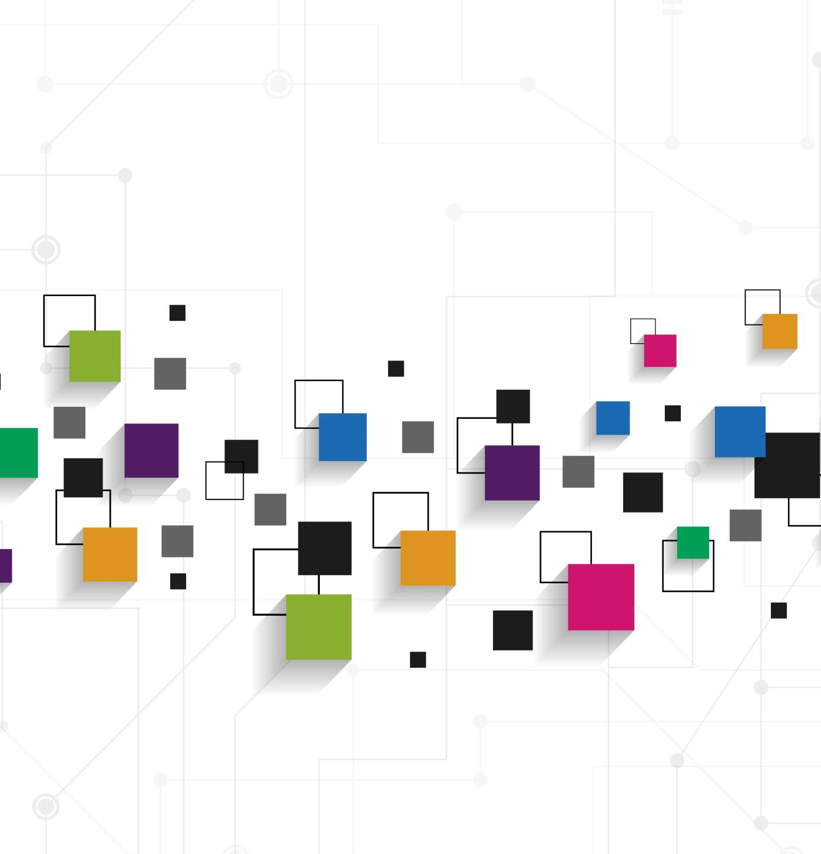
WHEN TO COMBINE BOTH (HYBRID APPROACH)
Different needs in a single application:
Relational Database Management: stores structured data like user accounts, orders or inventory.
Non-Relational Database Management: manages unstructured data like user-generated content, logs or activity streams.
Example 1:
For an e-commerce platform:
Relational database stores customers, orders and payment information.
Non-relational database handles product catalog, reviews, and real-time recommendations.
Example 2:
For a healthcare System:
Relational database is used for keeping patients records and billing.
Non-relational database is used for wearable device data, like heart rate and activity logs.
Combining both is helpful for optimizing performance, scalability, and data integrity.

Slide 14

THANK YOU!!!

